Slide 1


Slide 2

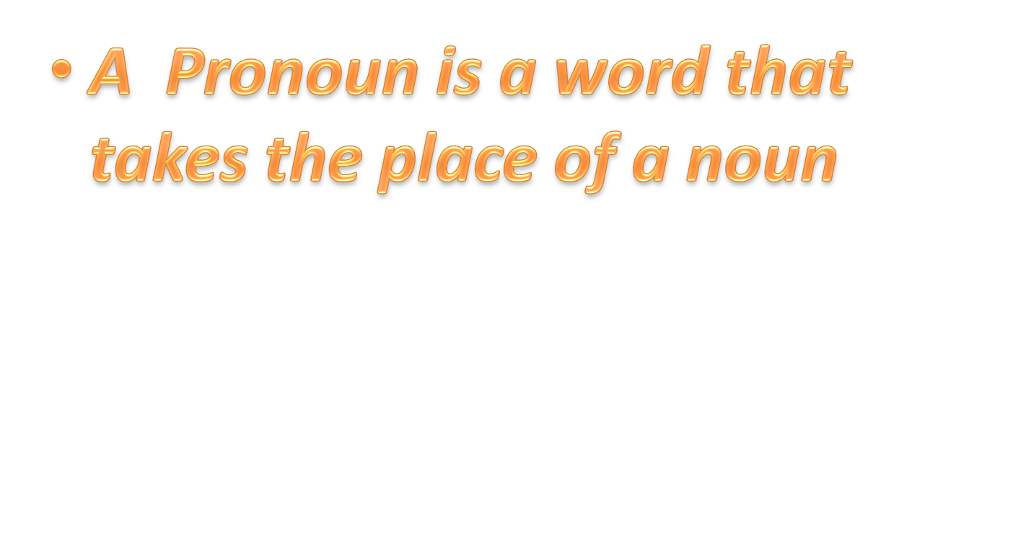

Slide 3

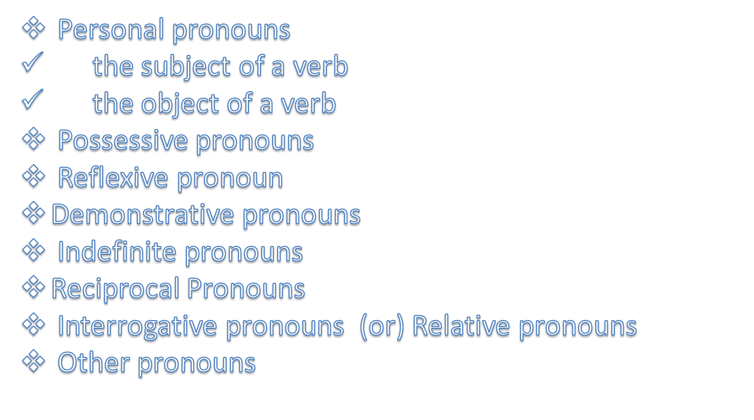

Slide 4
1. Personal Pronouns
The subject of a verb : -
I, you, he, she, it, we and they can all be used as the subject of a verb.
Examples :-
Lisa likes cats.
She has four cats.
Lisa – proper noun (subject)
She – pronoun (subject)
Sharma is a good teacher. He is a good player

Slide 5
The objective of a verb : -
me, you, him, her, it, us and them can all be used as the object of a verb.
Ex : -
Lisa likes cats. She likes to stroke them.
noun
Pronoun
the object of the verb
the object of the verb

Slide 6

 | Subject | Object
First person singular | I | Me
Second person singular | You | You
Third person singular | He | Him
 | She | Her
 | It | It
First person plural | We | Us
Second person plural | You | You
Third person plural | They | them

Slide 7

Possessive pronouns are used to talk about things that belong to people. The words mine, yours, his, hers, ours and theirs are possessive pronouns.
Examples :-
This book is mine.
Have you lost yours, Tom ?

Slide 8
Singular personal pronoun | Possessive pronouns
I , me | Mine
You | Yours
He ,him | His
She, her | hers
Plural personal pronoun | Possessive pronouns
We ,us | Ours
You | Yours
They , them | theirs

Slide 9

Reflexive pronouns are words that refer to the noun or pronoun that is the subject of the verb. The words myself, yourself, himself, herself, itself, ourselves, yourselves and themselves are reflexive pronouns.
Examples :-
My brother built this computer himself
John was looking at himself in the mirror

Slide 10
Some more examples :-
Be careful not to cut yourself with that knife.
Our cat washes itself after every meal.
We baked the cake by ourselves.
Come in, everybody, and find yourselves a seat.
The children cleaned their room all by themselves.
Bears like to rub themselves against a tree.
The bird washed itself by splashing in a puddle.
The players train every day to keep themselves it.

Slide 11
Singular personal pronoun | Reflexive pronoun
I (subject pronoun) | Myself
Me (object pronoun) | Myself
You (subject/object pronoun) | Yourself
He (subject pronoun) | Himself
Him(object pronoun) | Himself
She(subject pronoun) | Herself
It | itself
Plural personal pronoun | Reflexive pronoun
We (subject pronoun) | Ourselves
Us (object pronoun) | Ourselves
You(subject / object pronoun) | Yourselves
They (subject pronoun) | themselves
Them (object pronoun) | themselves

Slide 12

Demonstrative pronouns are used for pointing out things. The words this, that, these and those are demonstrative pronouns.
Examples:-
These are my pets.
These are sheep but those are goats.
Those are horses.

Slide 13
Some more examples :-
This is my desk.
This is the Mings' house.
That is my friend’s house.
That’s my mother’s car.

Slide 14

An indefinite pronoun does not refer directly to any other word. Most indefinite pronouns express he idea of quantity.
Examples :-
Everybody is welcome at the meeting.
Many prefer their coffee with sugar.
Does anybody care for a cheese sandwich?
Few choose to live in the arid desert.

Slide 15
Can you find indefinite pronoun in each sentence.
1. One never knows who might be listening.
2. Many are called but few are chosen.
3. I finished my cookie and asked for another.
4. Both were punished for the crime they committed.
5. Several applied for the job, but no one was hired.

Slide 16
Indefinite Pronouns :-
All | Each | Most | Other
Another | Either | Neither | Several
Any | Everybody | Nobody | Some
Anybody | Everyone | No one | Somebody
Anyone | Few | None | Someone
both | Many | One | such

Slide 17

It expresses a relationship between the individuals indicated in the plural subject
Examples :-
Two boys fought with each other.
Here :-Each other is reciprocal pronoun.
.

Slide 18
SOME MORE EXAMPLES
The boys fought with one another.
The members of the family love one another.

Slide 19
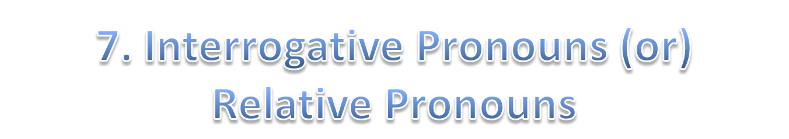
Interrogative pronouns are used to ask questions. The words who, whose, what, which and whom are interrogative pronouns.
Examples:-
Who used all my paper?
Who is Mom talking to?
Who are those people?

Slide 20
Some more examples :-
Whose pen is this?
Whose are these shoes?
What is your brother’s name?
What does Tom want?
What is the date today?

Slide 21
8.Other Pronouns
All | Each | Every | Another
Both | Either | Neither | Enough
Little | Less | Fewer | Many
Most | Several | Some | One
Any | Few | much

Slide 22


Slide 23
This powerpoint was kindly donated to www.worldofteaching.com
http://www.worldofteaching.com is home to over a thousand powerpoints submitted by teachers. This is a completely free site and requires no registration. Please visit and I hope it will help in your teaching.

